Slide 1

Pizza Restaurant sales
Lachandra Ash
11/15/2022

Slide 2


Agenda
The pizza restaurant sales many slices of pizza per day and wants to increase their revenue.
The pizza restaurant needs their pizza sales to be analyzed.

Slide 3

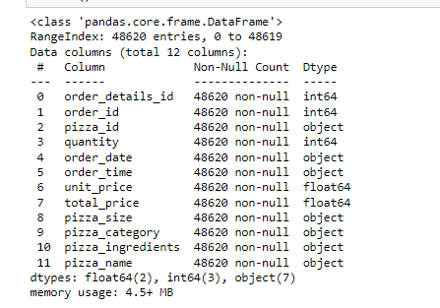

Pizza Sales Dataset

Slide 4


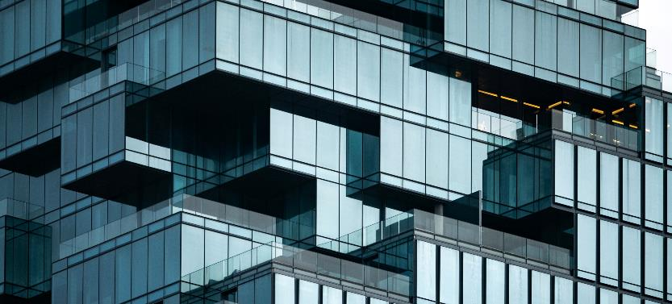
Total Price
Target Variable

Slide 5
Quantity of Pizzas
There are more single slices of pizza that were sold versus two, three, and four slices of pizza.

Slide 6
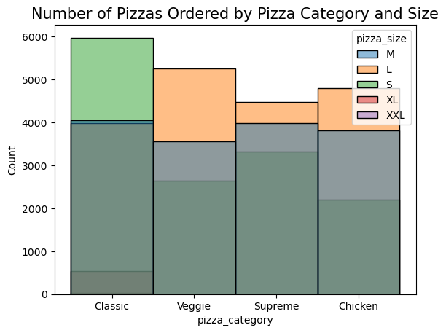
Pizza Category and Size
The classic pizzas had the highest number of sales, and highest number of small size pizza sells.
Veggie pizzas had the second highest number of sales, and the highest number of large sized pizza sells. Supreme had the least number of pizza sales.

Slide 7
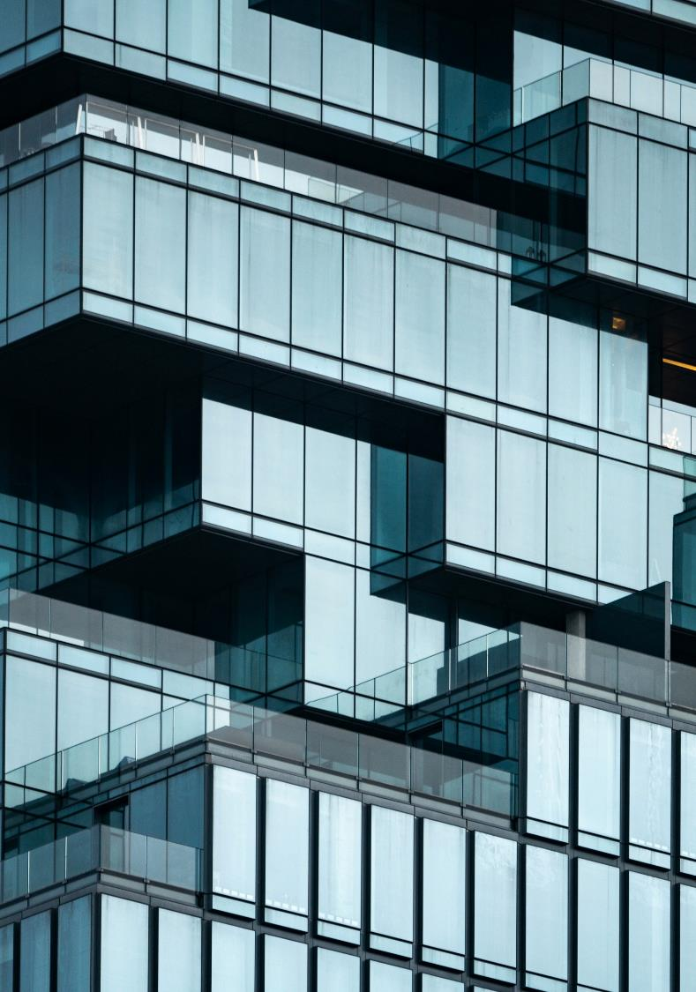
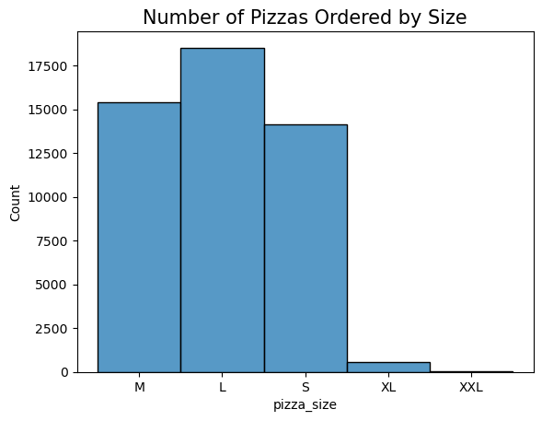
Pizza Size
The large pizzas had the highest number of sales, and the medium pizza had the second highest number of sales. The XXL and XL sized pizzas had the least number of sales.

Slide 8
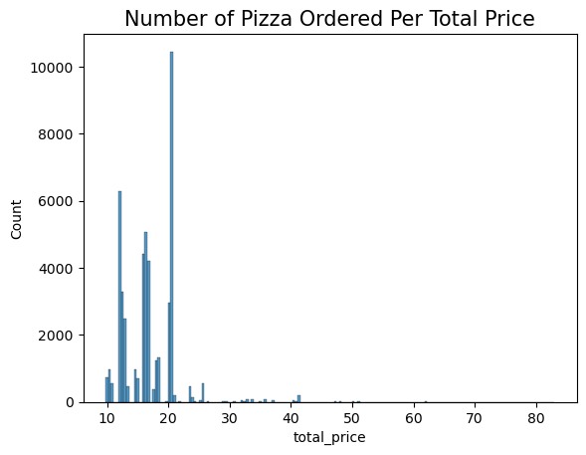
Total Price of Pizza
The total price of pizza with the highest number of pizzas sold was approximately $20.00.
The total prices of pizza greater than $20.00 had the least number of pizzas sold.

Slide 9
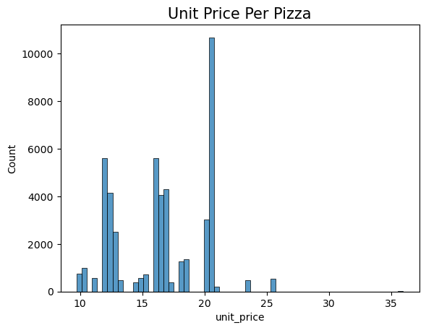
Unit Price
The unit price with the highest number of pizzas sold was approximately a little more than $20.00.
Pizzas with unit prices near $13.00 and near $16.00 - $17.00 had the second highest number of pizzas sold.

Slide 10
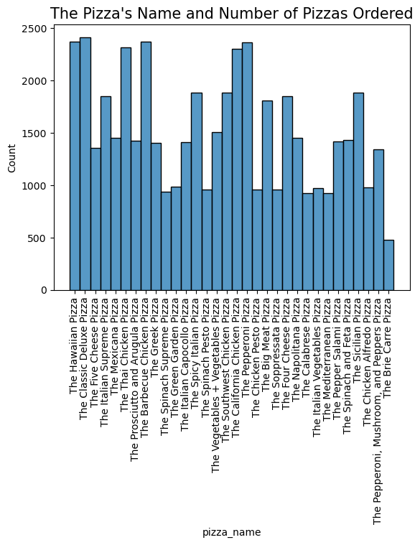
Pizza Name
The Hawaiian pizza, classic cheese deluxe pizza, thai chicken pizza, barbeque chicken, California chicken pizza, and pepperoni pizza had the highest number of sold slices of pizza.
The brie carrie had the least number of sold pizza slices.

Slide 11
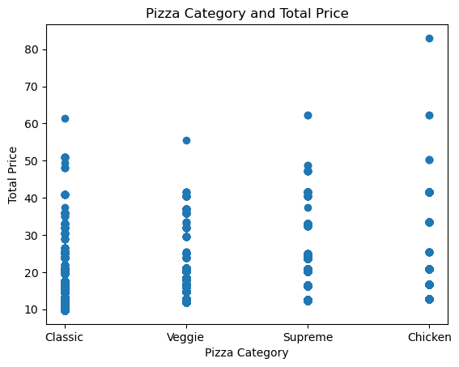
Pizza Category and Total Price
The classic pizza had the highest number of sold pizzas.
Veggie pizzas had the second highest number of sold pizzas.
Chicken pizzas had the least number of sold pizzas.

Slide 12
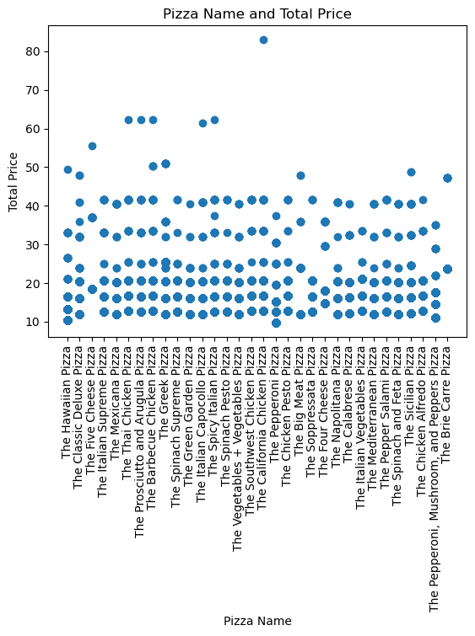
Pizza Name
Each pizza has almost the same number of unit price quantity of pizzas.

Slide 13
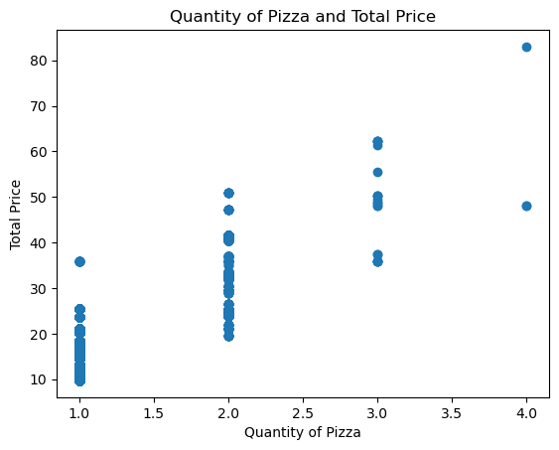
Quantity and Total Price
Four slices of pizza are more expensive, three slices of pizza are the second most expensive, and one slice of pizza is the least expensive.
Selling two slice of pizza is more popular than other slices of pizza

Slide 14
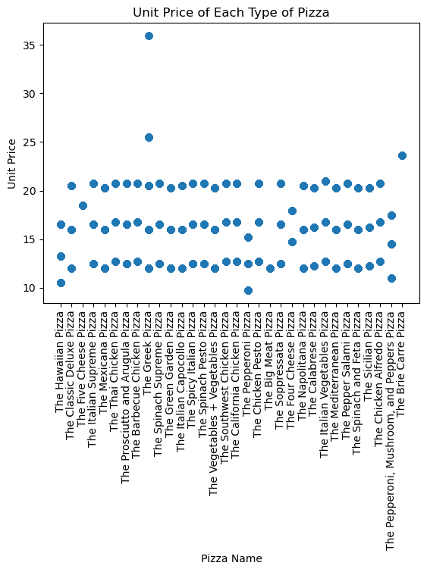
Unit Price vs. Pizza Name
Every pizza apears to have near the same unit price.

Slide 15

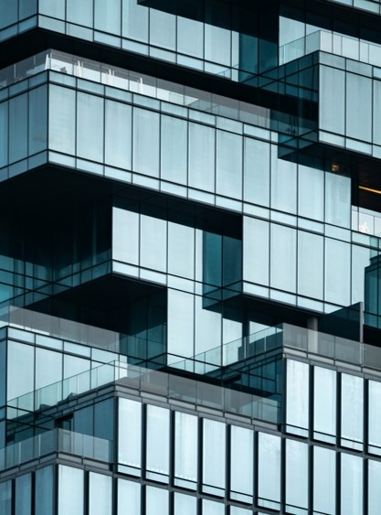


Conclusion
The greatest number of slices of pizzas sold at the same time are two.
The pizza restaurant can earn more revenue by selling more two slices of pizza and single slices of pizza
.Selling three and four slices of pizza is less popular and more expensive..
The classic pizzas were sold the most, and the restaurant should focus on selling more classic and veggie pizzas since they are most popular.
The restaurant can also form some type of strategy to make the supreme and chicken pizzas become more popular and bring in a lot more sales.
The restaurant should think about reducing the total price and unit price of the pizzas to sell more pizzas to their consumers.
The restaurant needs to focus on increasing the sales for XL and XXL sized pizzas.

Slide 16
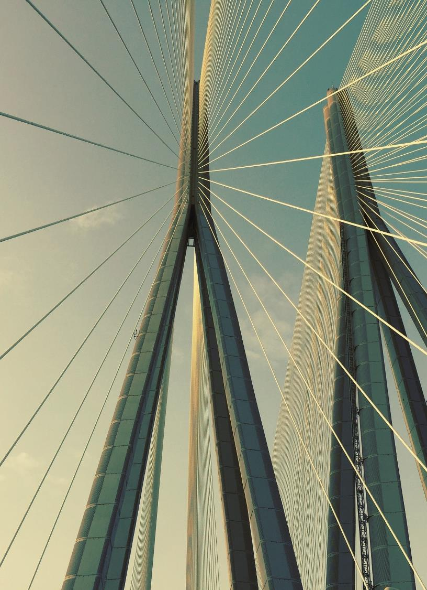
Thank you

